Slide 1

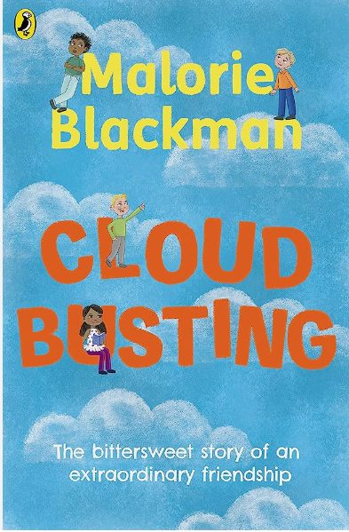
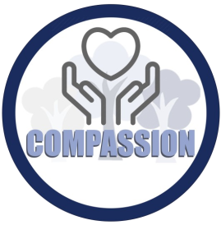
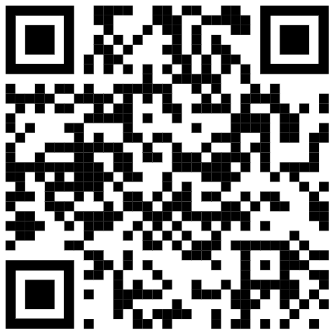
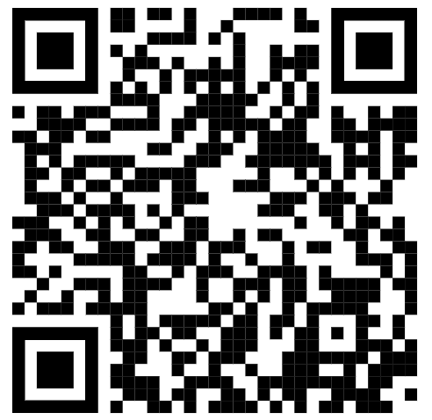

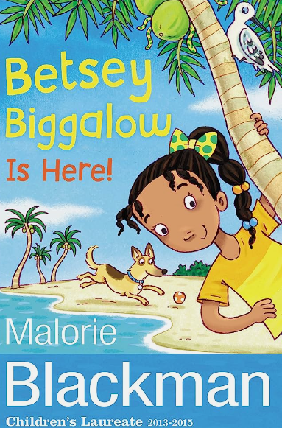

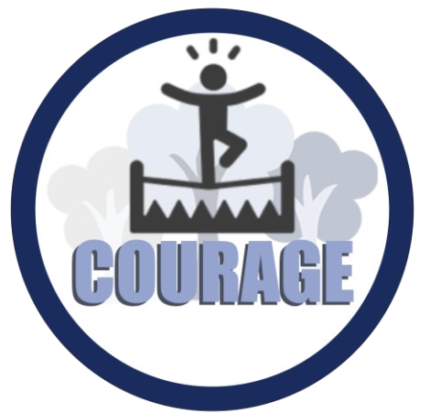


Year 4 – Term 1 – Book Warmer
‘Cloud Busting’ by Malorie Blackman
Cloud Busting is about an unlikely friendship between 2 very different boys, Sam the class bully and Davey.
Watch this video on how to write a poem in 3 minutes and give it a go yourself!
What makes you unique? Watch this video; take time to discuss what makes you and people in your family special. How can you learn from each other?
Other books by Malorie Blackman
Our theme this term:
Sam, the bully, makes Davey who is imaginative and a born poet made look like a class idiot.
Community

