Slide 1







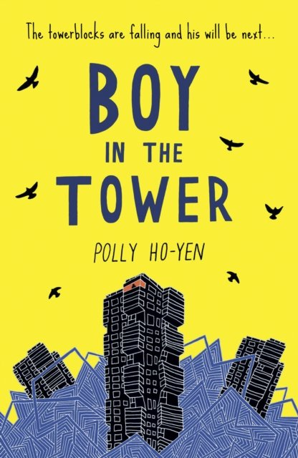
Year 5 Autumn Term 2
ENGLISH
KEY MESSAGES
Our English text for this term is Boy in the Tower, by Polly Ho-Yen. We will begin the term by focusing on poetry, and exploring figurative language techniques.
As the term progresses, we will be writing newspaper reports.
MATHS
In maths, we will be exploring multiplication and division, and learning about factors, prime numbers and square numbers. We will then be moving on to fractions.
.
Please ensure your children consolidate their times table knowledge.
Home Learning:
‘ATOM Learning’ is being set every Friday and is expected to be completed by the following Friday.
TT Rockstars should be used 5 times a week to develop rapid recall skills.
Reading – A little each night is best. When your child has read, sign their book each day so they can earn their coloured band! Reading records will be collected and signed on a Thursday each week.
Reminders:
Please name all belongings – bags, water bottles, lunch boxes, fruit pots, coats, cardigans/jumpers, and PE kits.
Term 2 text

Slide 2

Year 5 Autumn Term 2
COMPUTING:
This term in Computing we will be thinking about digital literacy, including communication and collaboration.
D.T:
PSHE & RE:
This term the children will be entering into the world of fashion and designing and creating a garment using old clothing.
.
PSHE : In PSHE, we will be continuing our learning about how to help others, moving on to recognising and managing feelings of anger.
R.E. : Our focus for RE this term is based around the question, “What does it mean to be a Muslim in Britain today?”
PE:
P.E. will be on a MONDAY and WEDNESDAY this term.
We will be focusing on Korfball and Hockey.
SCIENCE:
FRENCH:
HISTORY:
MUSIC:
Our topic for French this term is Space Exploration! We will be forming factually and grammatically correct phrases to compare two planets in terms of their size and temperature.
We will be continuing to study properties of materials, including designing our own water filtering system.
Our history this term will be the Viking and
Anglo-Saxon struggles. Additionally, the impact the Vikings made on society.
We will be creating a Christmas carol using a popular melody, writing our own verses, chorus and bridges.
Add here

