Slide 1






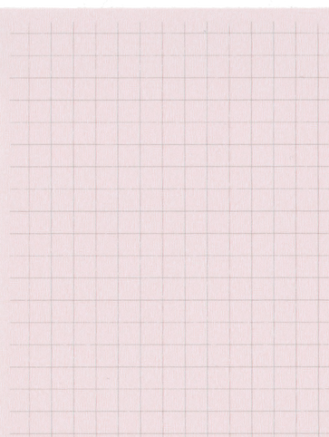
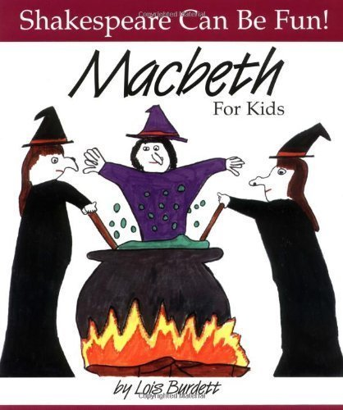
Year 6 Autumn Term 2
ENGLISH
KEY MESSAGES
This term, children will be introduced to the world of Shakespeare. Our class text will be Macbeth by Lois Burdett. The story is written in rhyming couplets making it child friendly and very enjoyable.
We will use this text as inspiration for our fiction, non-fiction and poetry writing.
MATHS
Welcome to Term 2!
The Year 6 team wish you all a wonderful half term and hope you all get some rest after a very busy term 1.
Homework expectations:
Reading daily
Timetable practice
Atom learning weekly
During Term 2, children will continue to deepen their understanding of the four operations as well as explore new topics including fractions and converting units.
Macbeth

Slide 2

Year 6 Autumn Term 2
COMPUTING
ART
This term in computing we will be exploring programming using micro-bits.
PSHE & RE
This term in the art studio, children will be ‘exploring identity’ using a range of mediums.
In PHSE, we will exploring ‘worry’ and learning to recognise the signs, in addition to strategies to support this emotion.
In RE, we will attempt to answer the following: Is it better to express your beliefs in arts and architecture or in charity and generosity?
PE
Children will be participating in invasion with the focus being progressing skills in football and netball.
SCIENCE
French
HISTORY
Our science topic for this term is ‘Electricity’. Children will be hands on using components to prove or disprove their hypothesis’.
Children will continue to develop their written French or oral pronunciation focused on our topic – the weather.
Children will embark on learning about the Ancient Islamic civilization of Bagdad and how this influences modern life.
MUSIC
Children will be listening and composing using glockenspiels.
Add here

